Slide 1
Data Analysis of Breweries and Beer
Andre Mauldin, Lijju Mathew, Michael Olheiser (Team Floating Point)
July 1st, 2020

Slide 2
Outline
Breweries by State
Handling Missing Values
ABV and IBU by State
Highest ABV and IBU Beers
Distribution of ABV of IBU
Relationship between ABV and IBU
KNN Classification of Beer Types
Top 5 Most Common Beers
Conclusions

Slide 3
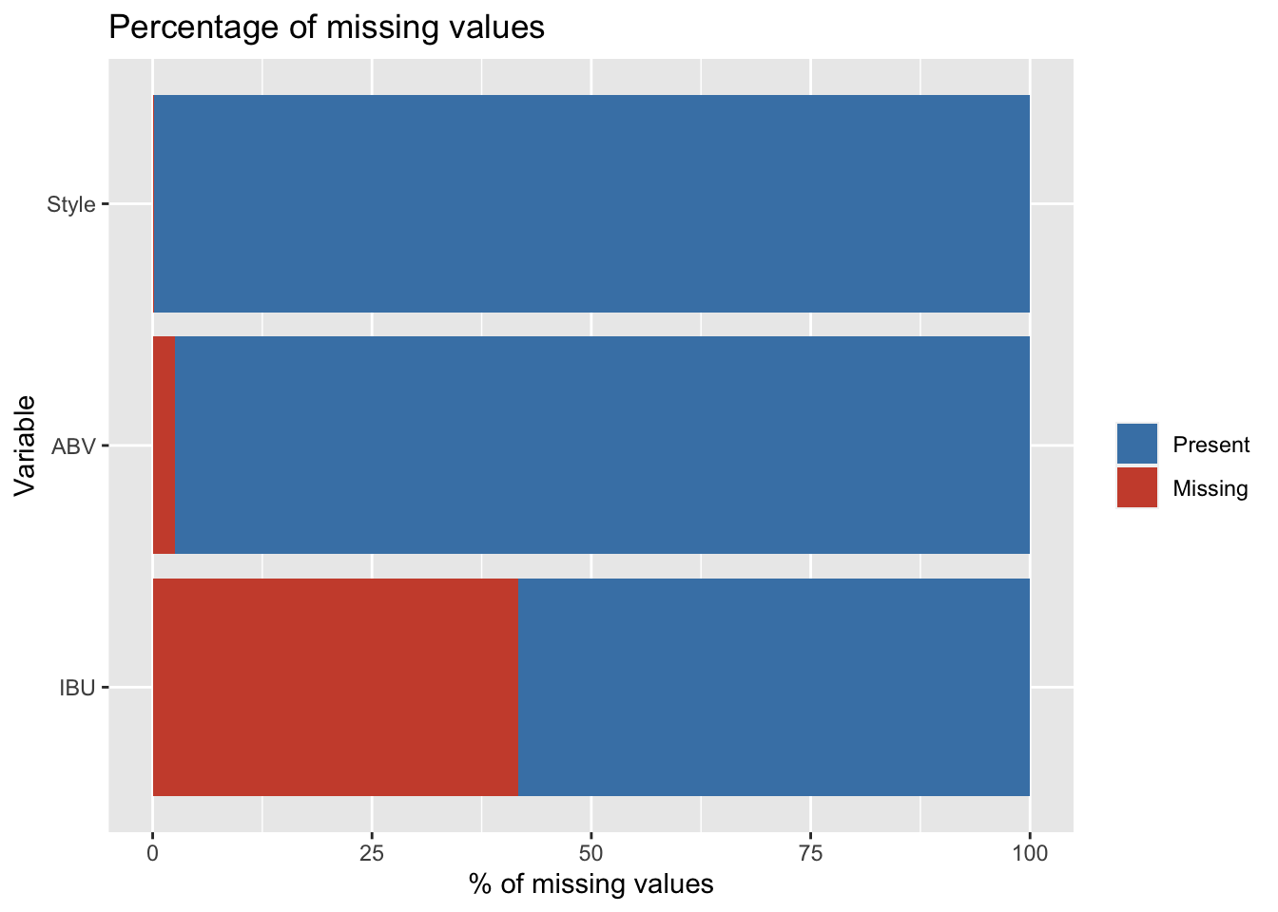
Handling Missing Values
IBU is not regularly reported per beer
Replace missing values with average IBU/ABV in that style
9 styles of beer do not contain any reported IBUs including 37 Ciders
Set IBU to zero for Cider. Drop remaining styles with no IBUs.
Result: Drops 20 beers out of 2410.

Slide 4
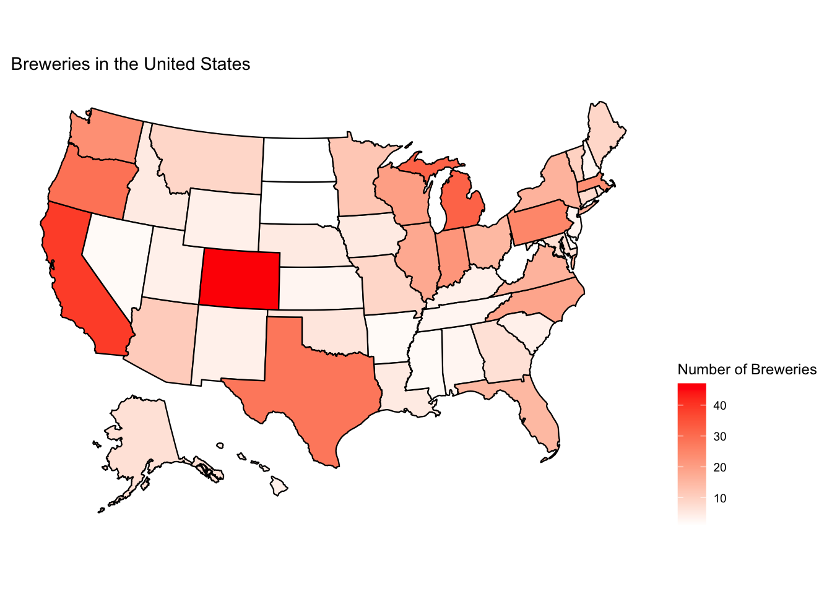
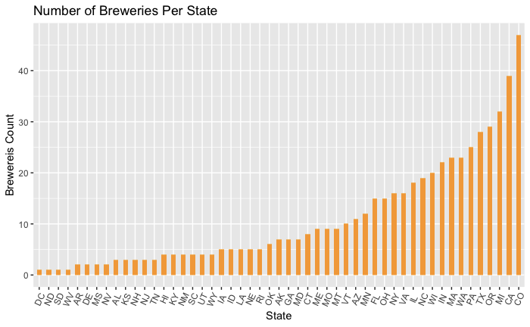
Distribution of Breweries across the United States
California, Colorado, Michigan contain the most breweries in the US
No specific region that is dominated by breweries
Population is not the only factor affecting the presence of breweries

Slide 5
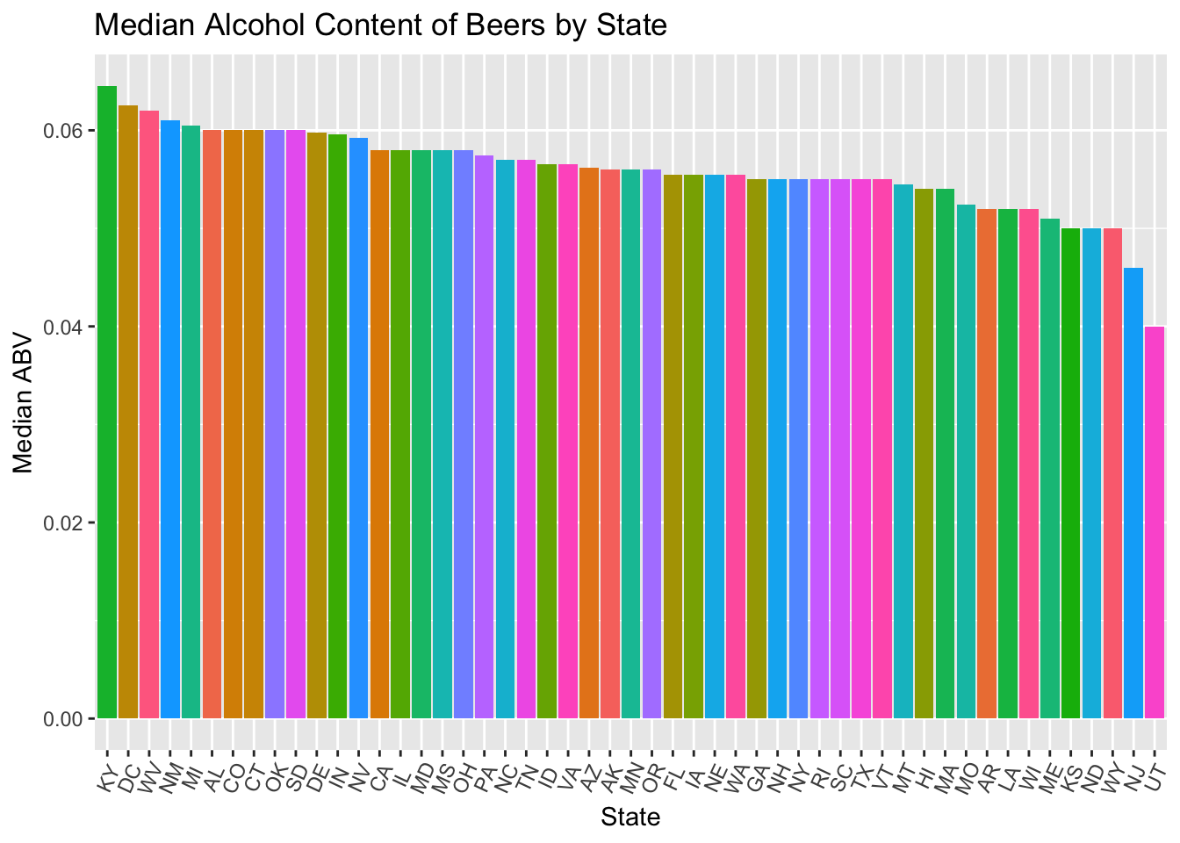
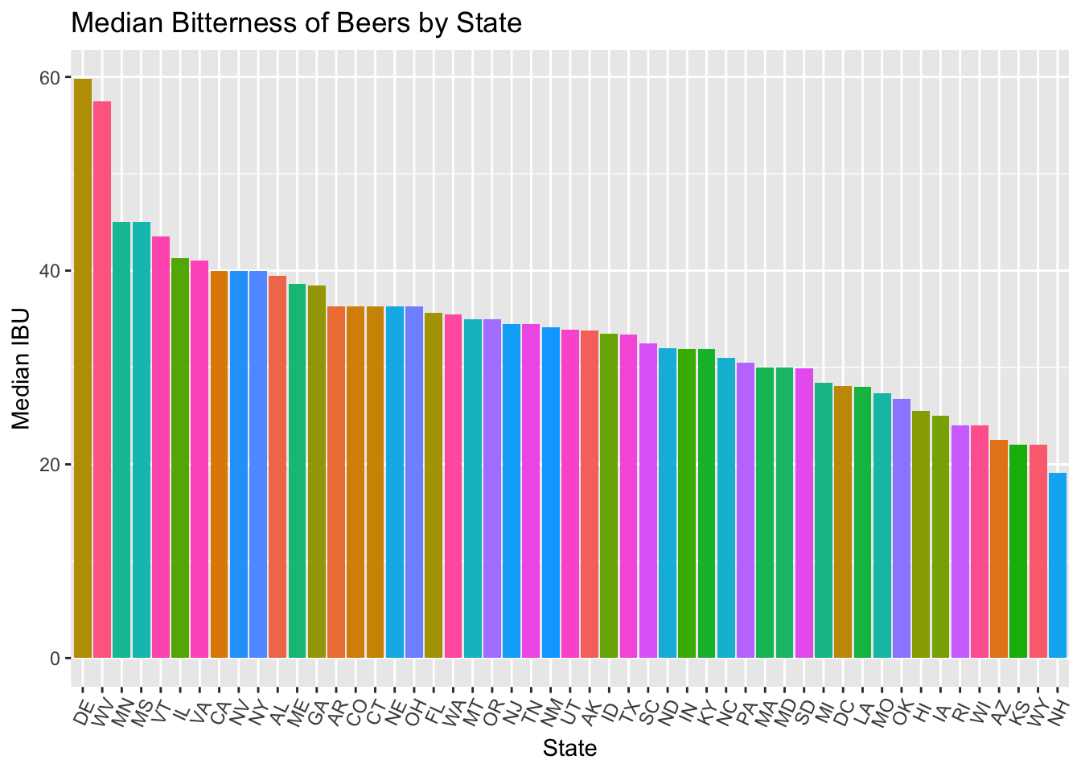
Median IBU and ABV by State
Median ABV varies less across states than median IBU
No obvious geographical/regional pattern.
A higher Median ABV does not necessarily indicate higher ABV ( see next slide)

Slide 6
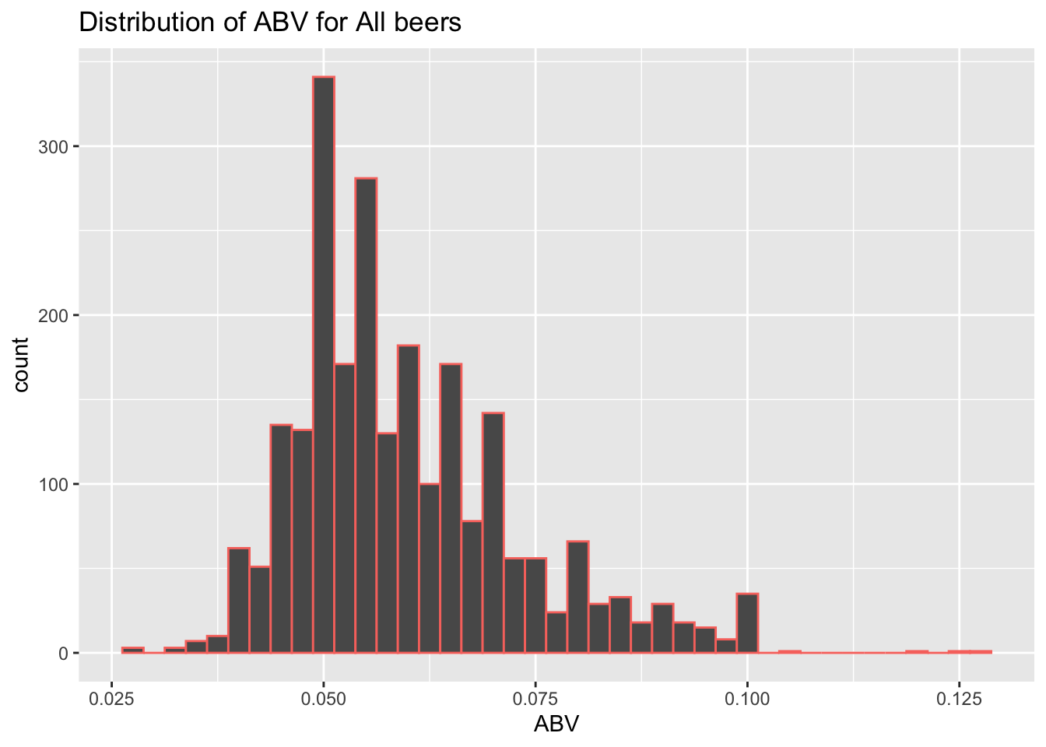
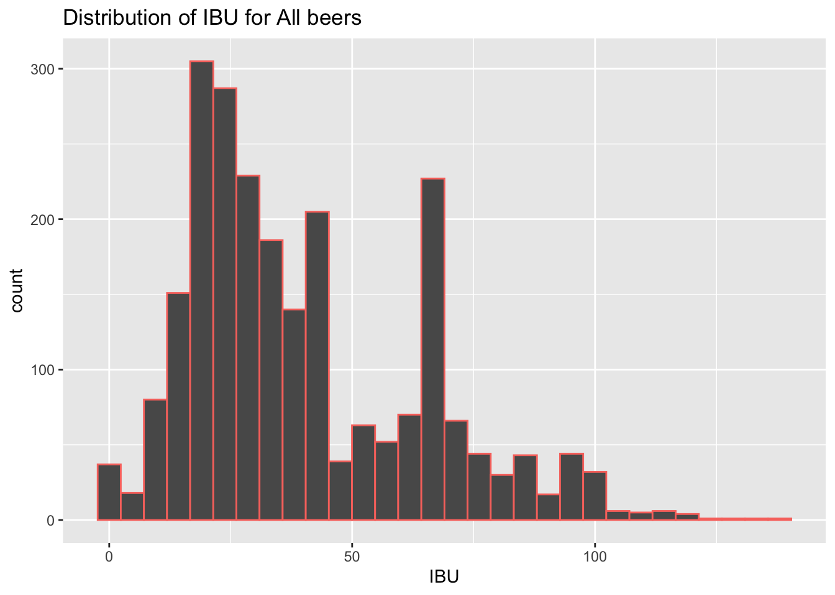
Distribution of Alcoholic Content of Beers
Median = 0.05600
Mean = 0.05974
Distribution is slightly right-skewed as beers are not typically strong alcoholic drinks.
Median = 33.81
Mean = 40.27
Distribution may be bi-modal.

Slide 7
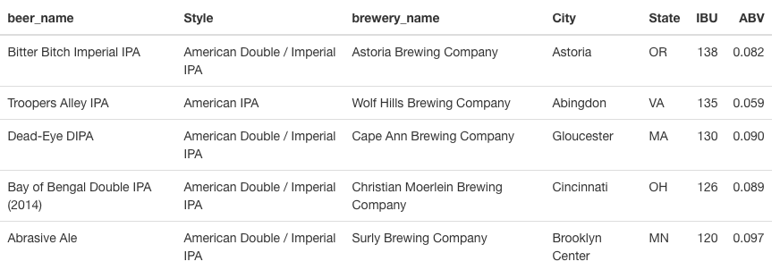
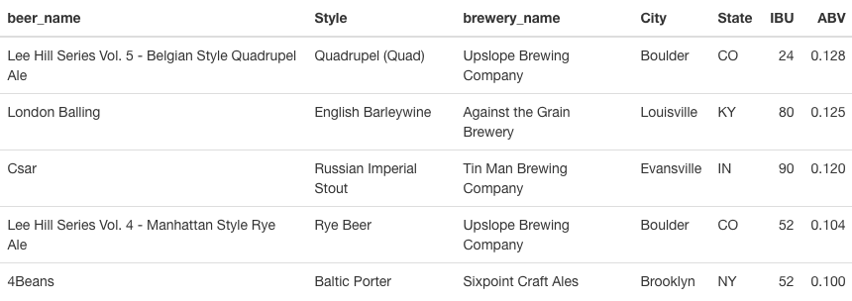
Top IBU and ABV Beers in the US
Top 5 IBU Beers
Boulder, CO has 2 of the top 5 ABV beers
Top 5 IBU beers are all American IPAs
Top 5 ABV Beers

Slide 8
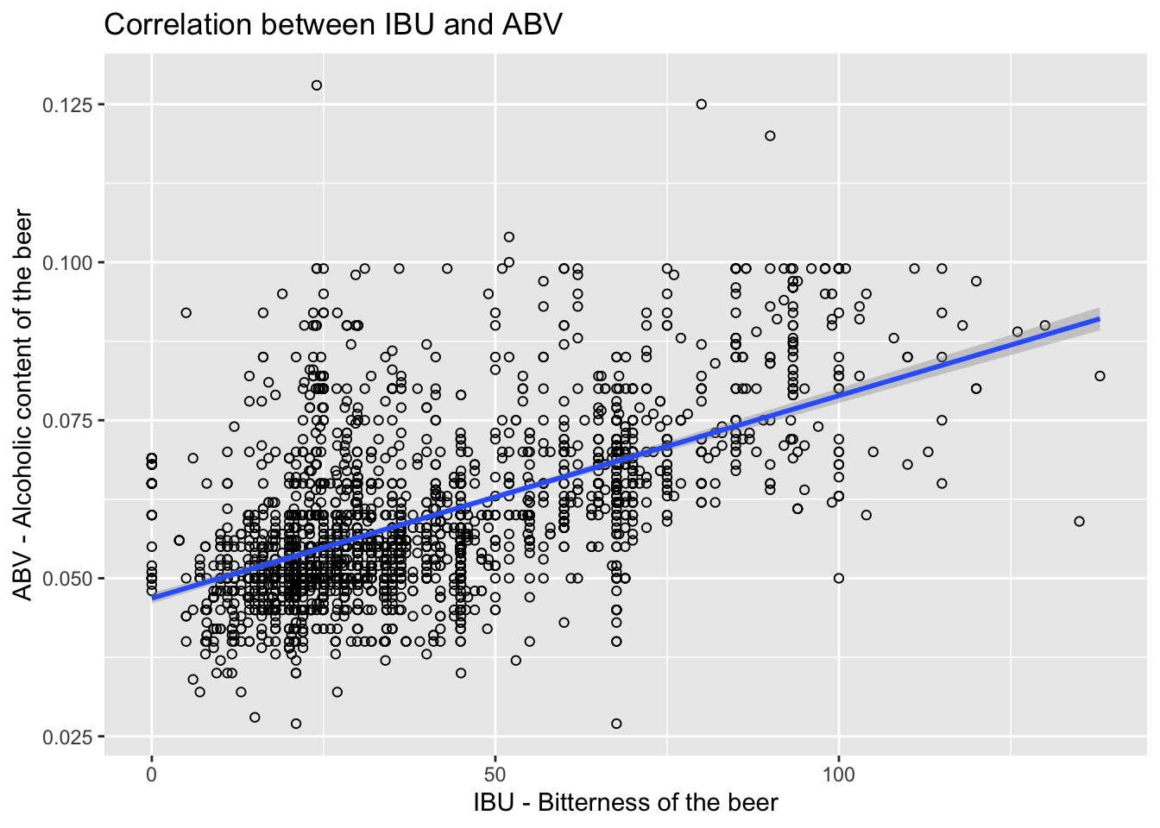
Relationship between IBU and ABV
Positive correlation
Correlation value = 0.58
95% CI (0.55 , 0.61)
Data is sparse beyond ~60 IBU.
There is not strong evidence against equal variances indicating a linear regression may be an appropriate model here.

Slide 9
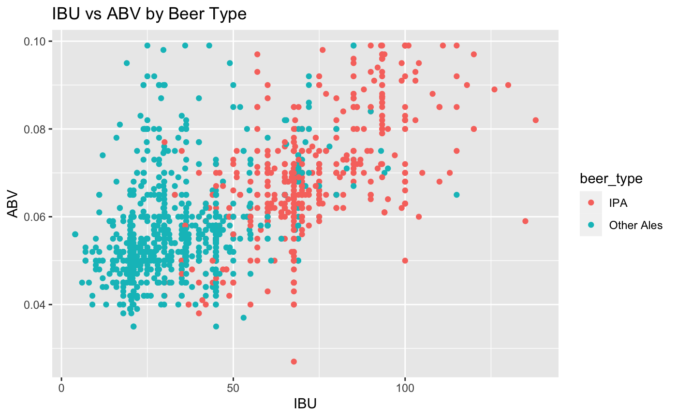
Classification of Beer Styles by IBU and ABV
Confusion Matrix ( Columns are predictions)
Beer Type | IPA | Other Ales
IPA | 156 | 20
Other Ales | 30 | 254
Accuracy
0.891
IBU are clearly higher for IPA than other Ales and span a larger range.
IPAs tend to be higher ABV than Other Ales

Slide 10
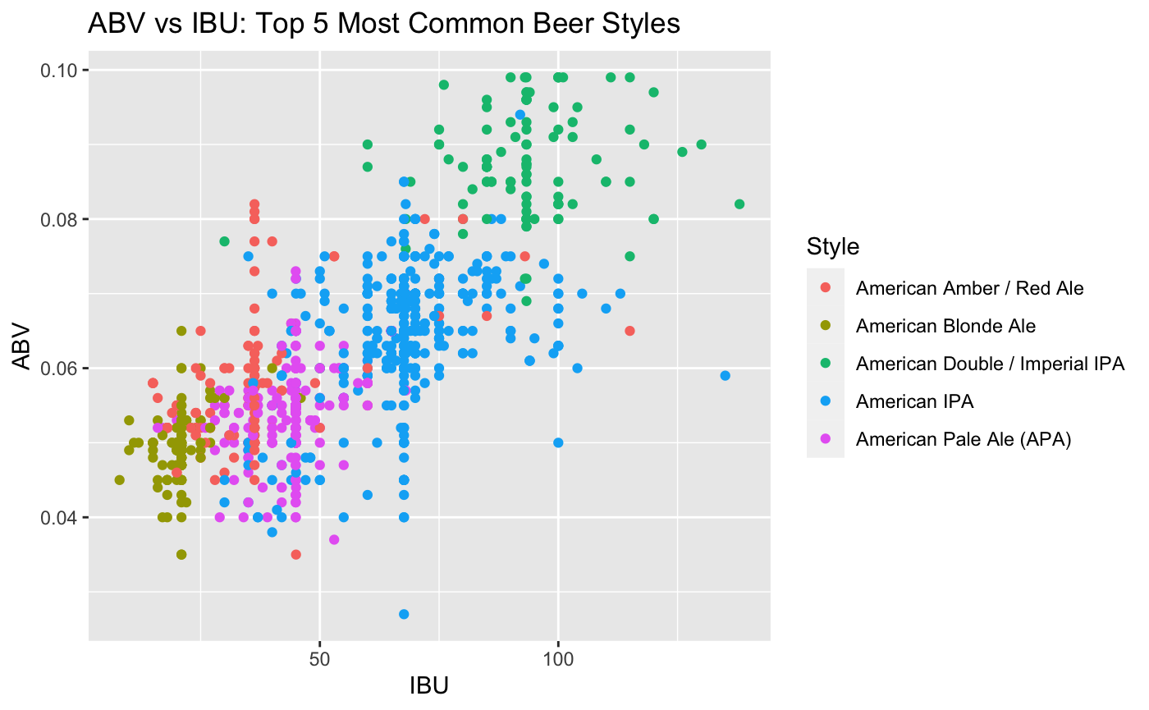
Classification of Top 5 Most Common Beer Styles
Top 5 Most Common Beer Styles
(Columns are Predictions)
Style | Count
American IPA | 424
American Pale Ale (APA) | 245
American Amber / Red Ale | 133
American Blonde Ale | 108
American Double / Imperial IPA | 105
Considerable overlap among Styles

Slide 11
KNN Classification Results for Top 5 Most Common Beer Styles
Confusion Matrix (Columns are Predictions)
 | American Amber / Red Ale | American Blonde Ale | American Double / Imperial IPA | American IPA | American Pale Ale (APA)
American Amber / Red Ale | 14 | 10 | 0 | 6 | 13
American Blonde Ale | 6 | 20 | 0 | 0 | 1
American Double / Imperial IPA | 0 | 1 | 23 | 11 | 1
American IPA | 2 | 0 | 11 | 102 | 8
American Pale Ale (APA) | 7 | 3 | 0 | 9 | 57
American Amber/Red and Blonde Ales are difficult to classify due to the overlap with other styles.
Pale Ale, IPA, and Imperial IPAs are more distinctly separated by IBU/ABV hence
In general, styles are more distinct as IBU and ABV is increased.
Model Results by Style (Overall Accuracy = 0.71)
Beer Style | Balanced Accuracy per Style
American Amber / Red Ale | 0.6888431
American Blonde Ale | 0.7812025
American Double / Imperial IPA | 0.8142501
American IPA | 0.8391155
American Pale Ale (APA) | 0.8140278

Slide 12
Conclusion
Key takeaways
No obvious regional patterns in the US of brewery locations
IBU not regularly reported
Positive linear relationship between IBU and ABV
Bi-modal distribution of IBU – possibly different markets?
Not all styles of beer can be accurately classified by IBU/ABV
Further research
Distribution/Sales data – where is the beer going?
Demographics, economics of states

